Slide 1
Assignment #4:
Concept video
Team Papaya: Lucy Zhu, Zheng Lian, Xiaohai Liu, Cathy Wang

Slide 2
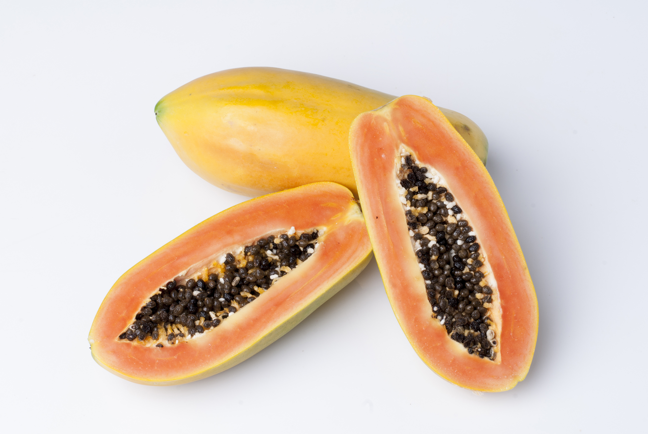
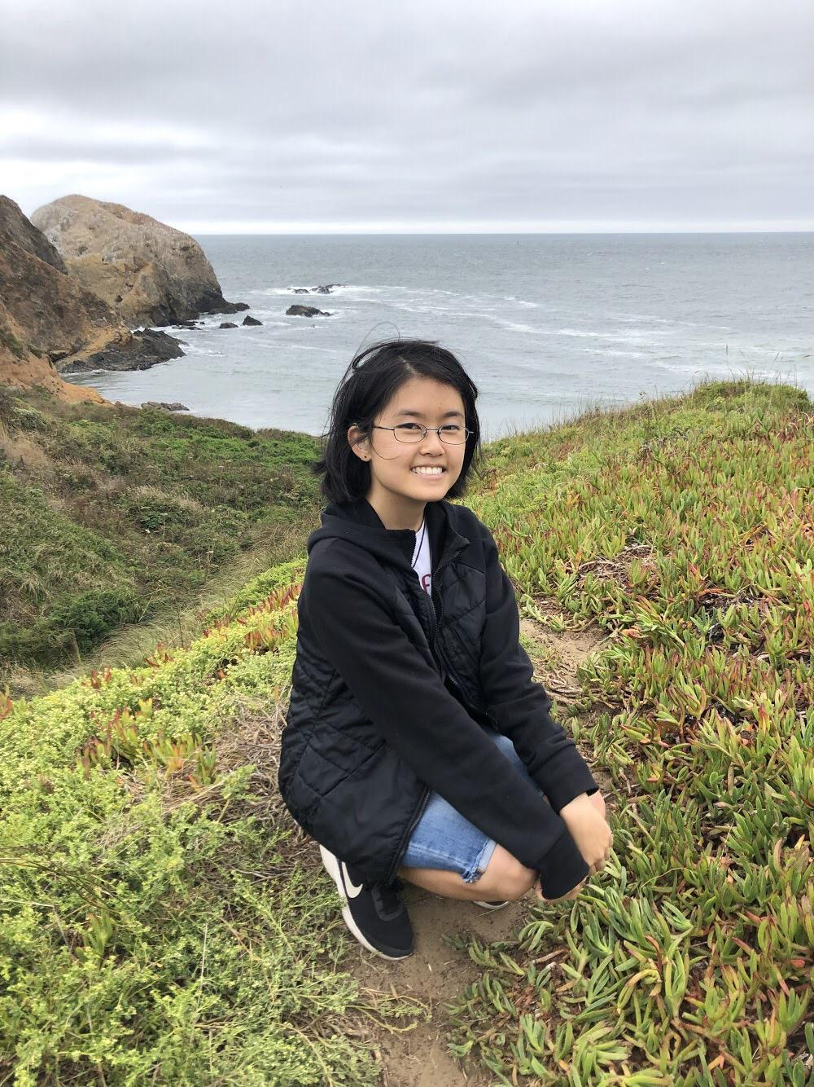
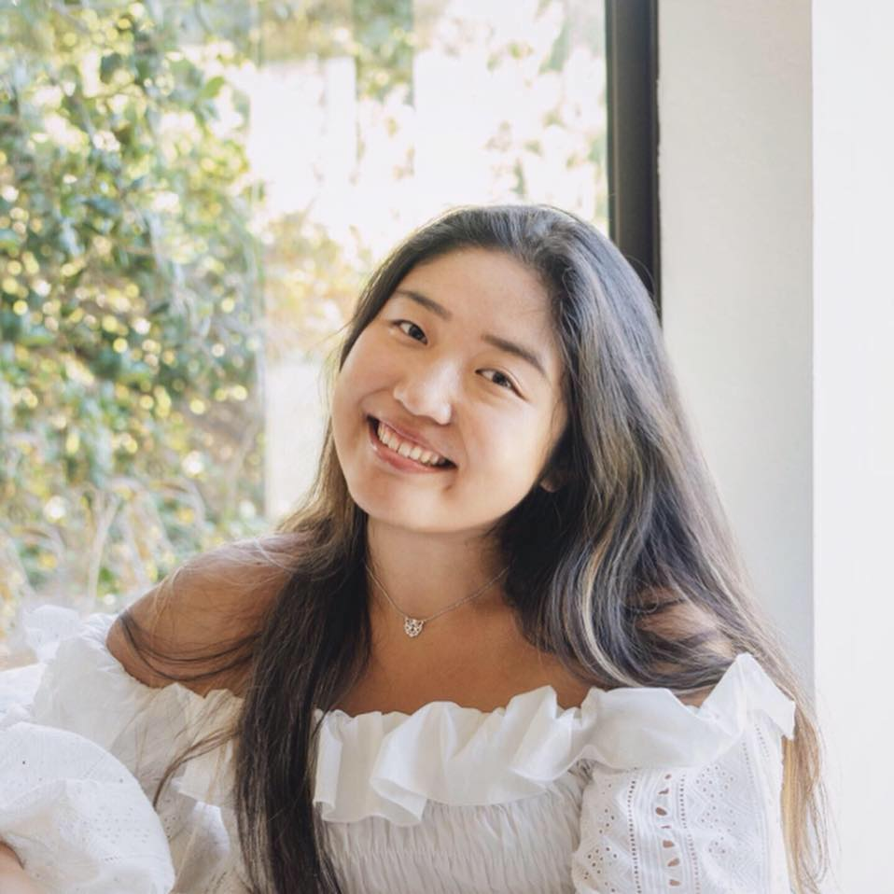
🌟Zheng
🌟Xiaohai
🌟Lucy
🌟Cathy
Team Papaya
Notes:
Our team consists of 4 people: Zheng, Xiaohai, Lucy and Cathy!

Slide 3
Value Proposition
Tailor Swiftly:
“Visualize your first design”

Slide 4
Tasks
Easy:
To create a shareable space demonstrating fashion designs

Slide 5
Tasks
Medium:
To create a fashion design using existing parts

Slide 6
Tasks
Complex:
To generate and share a design from scratch

Slide 7
✨Storyboard✨

Slide 8
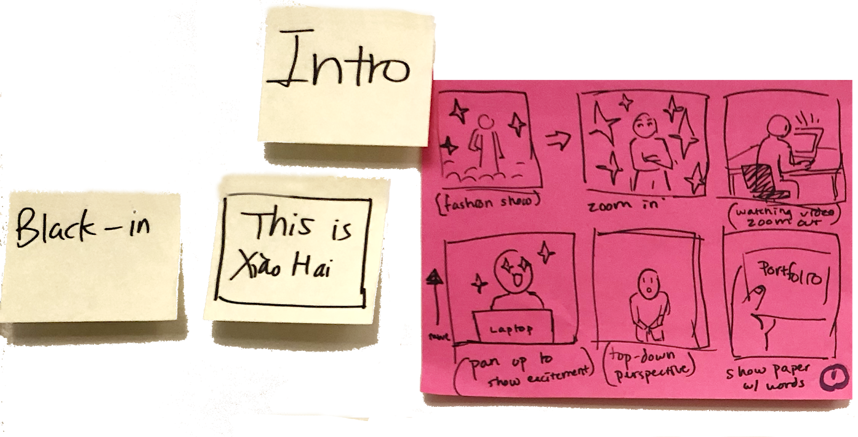

Slide 9
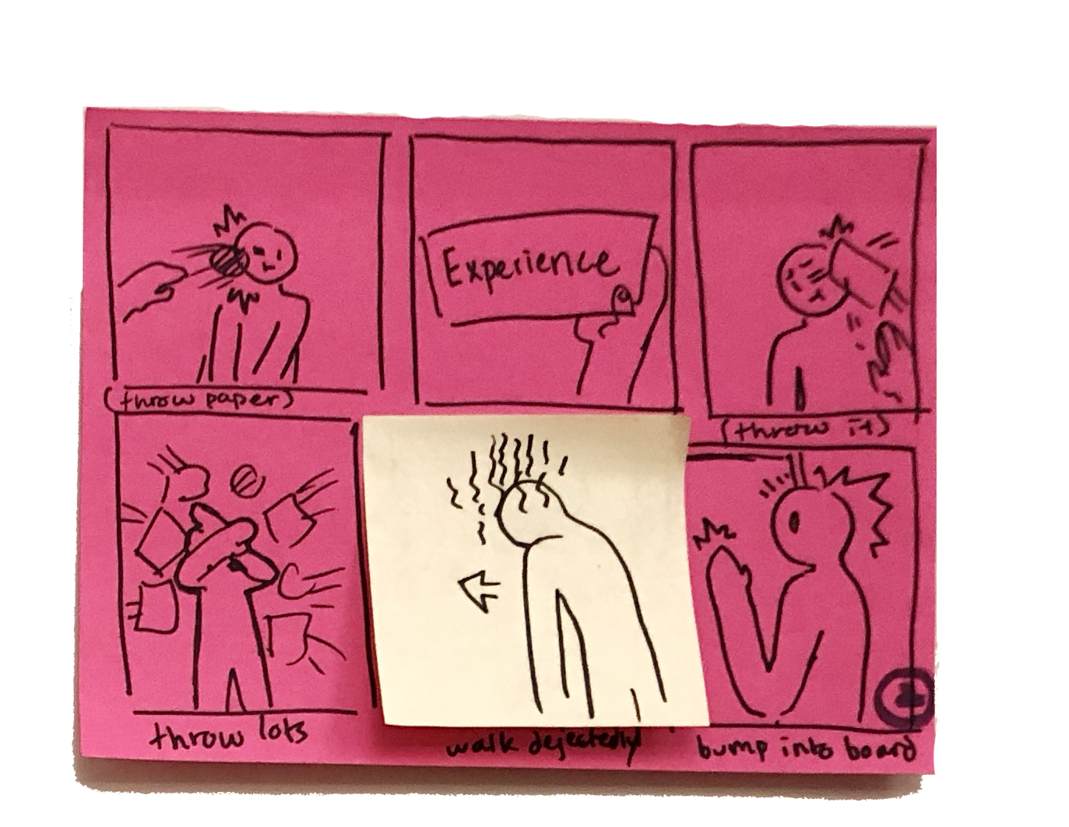

Slide 10
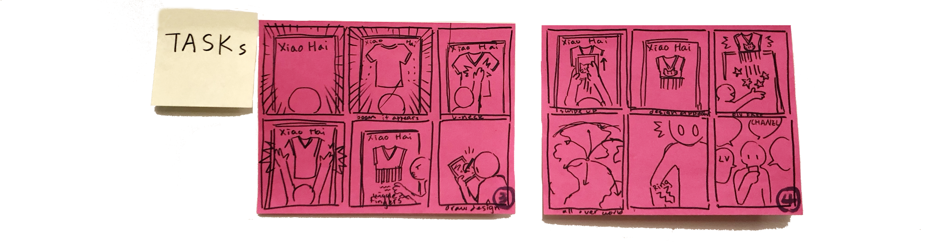

Slide 12


Slide 13
*Appendix*

Slide 14
Concept Video
Concept Video On YouTube

Slide 15

Clips Used:
https://www.youtube.com/watch?v=JJHLgD6uqf0
Dior | Fall Winter 2019/2020 Full Fashion Show | Exclusive
https://www.youtube.com/watch?v=MhywuOubsZU
Anna Wintour On the Highlights of Paris Fashion Week | Vogue
https://www.youtube.com/watch?v=n8ZHZRdGPPc
Fashion Week 2019 | Street Style Photography
https://www.youtube.com/watch?v=367veujwj_Y
What Does it Take to Be A Fashion Designer?
https://www.youtube.com/watch?v=mLYDHUECDdo
LP Design - Lighting Globe Animation
https://www.youtube.com/watch?v=OVs4MUT-Oeo
4k World Globe Animation Free Stock Footage no copyright
https://www.youtube.com/watch?v=ty2jwBxxmHw
Globe rotation animation

